Slide 1

CSE3020 : PRODUCT DEFINITION AND VALIDATION
BillBook - Billing Pattern made simple!
19BCE7490 – Talasila Sri Harsha
19BCN7062 – Abhipray Adhik Chavan
19BCE7097 – Neha Chowdary
Group-4
Guided By: Dr. Hussain Syed

Slide 2
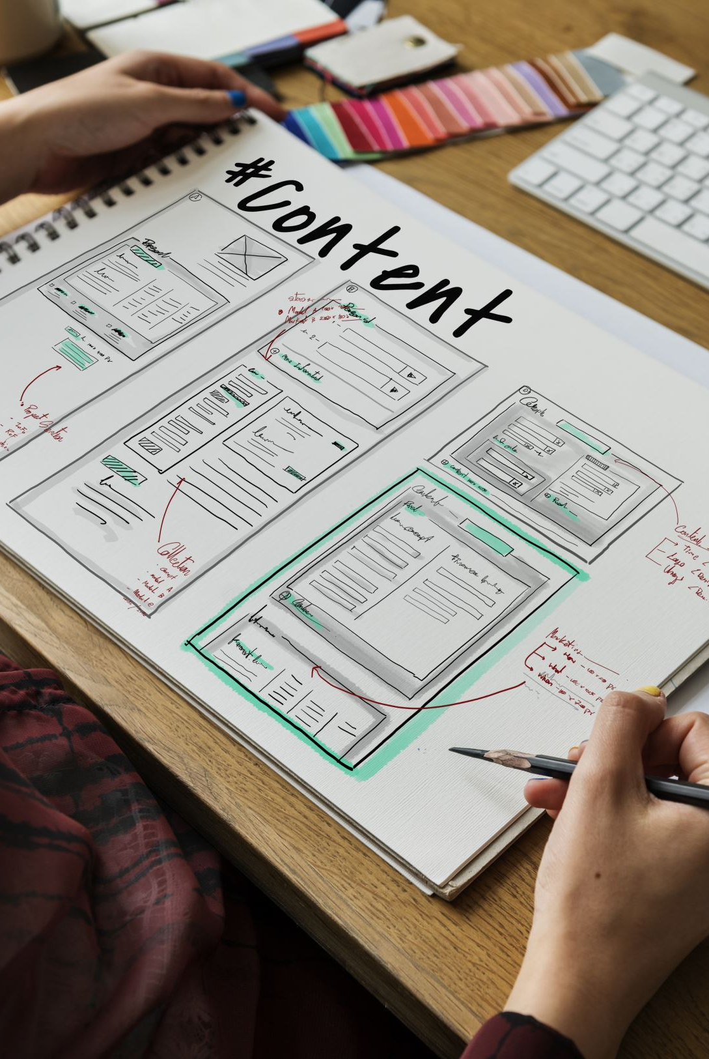
CONTENT
System Architecture
UML Diagrams
Project Charter

Slide 3
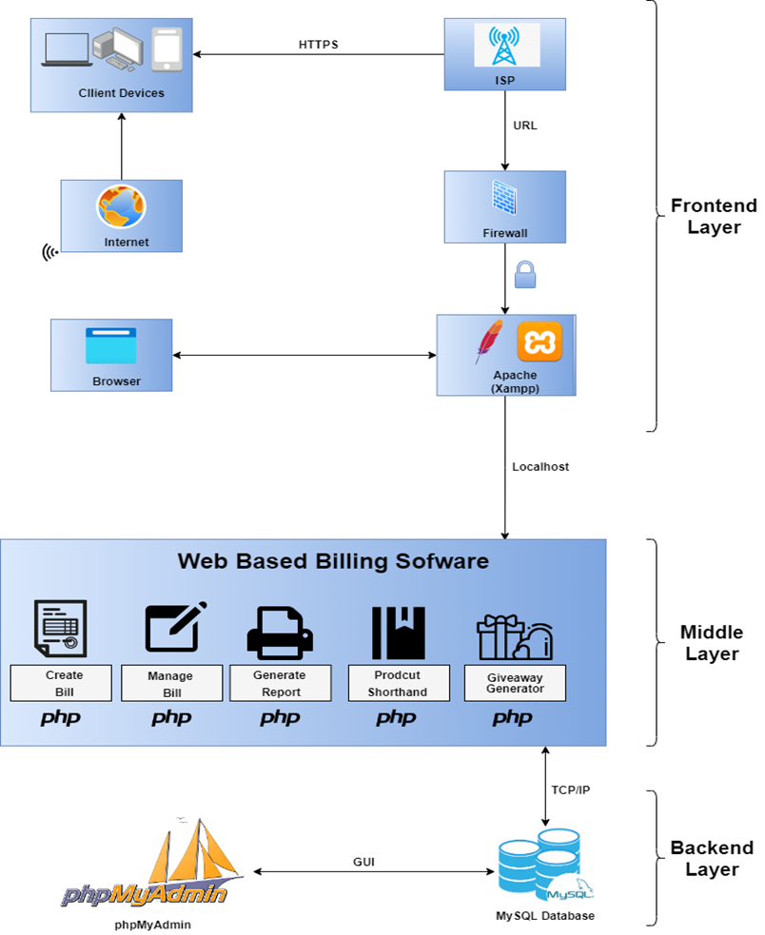
System Architecture

Slide 4
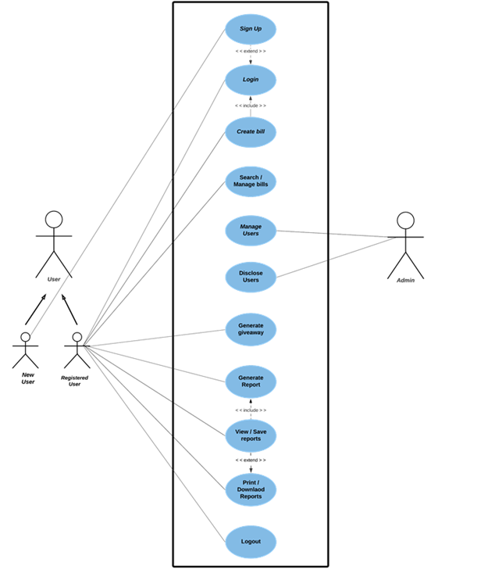
Use-Case Diagram

Slide 5
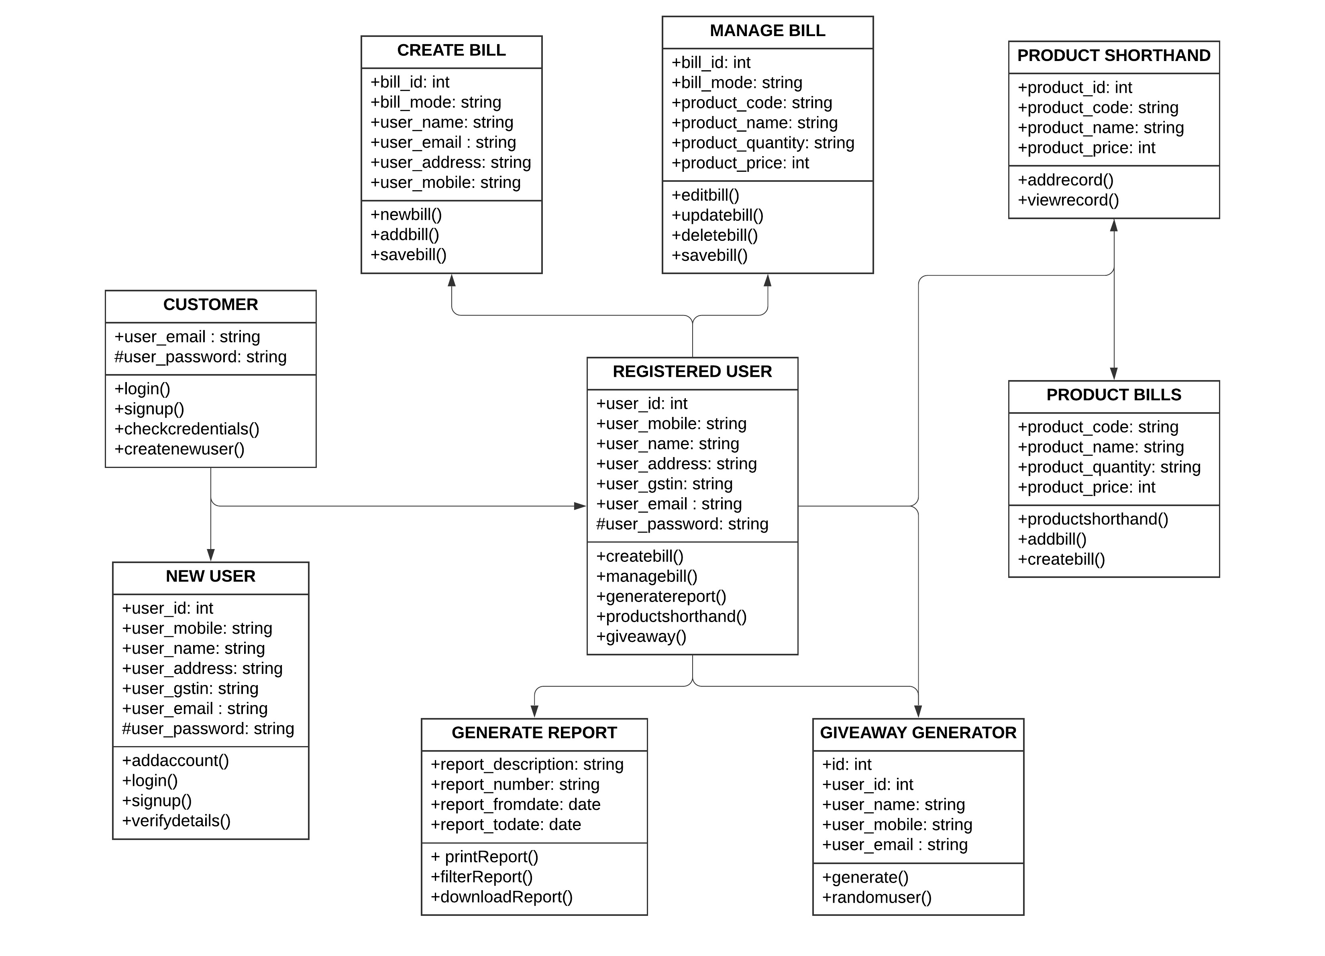
Class Diagram

Slide 6
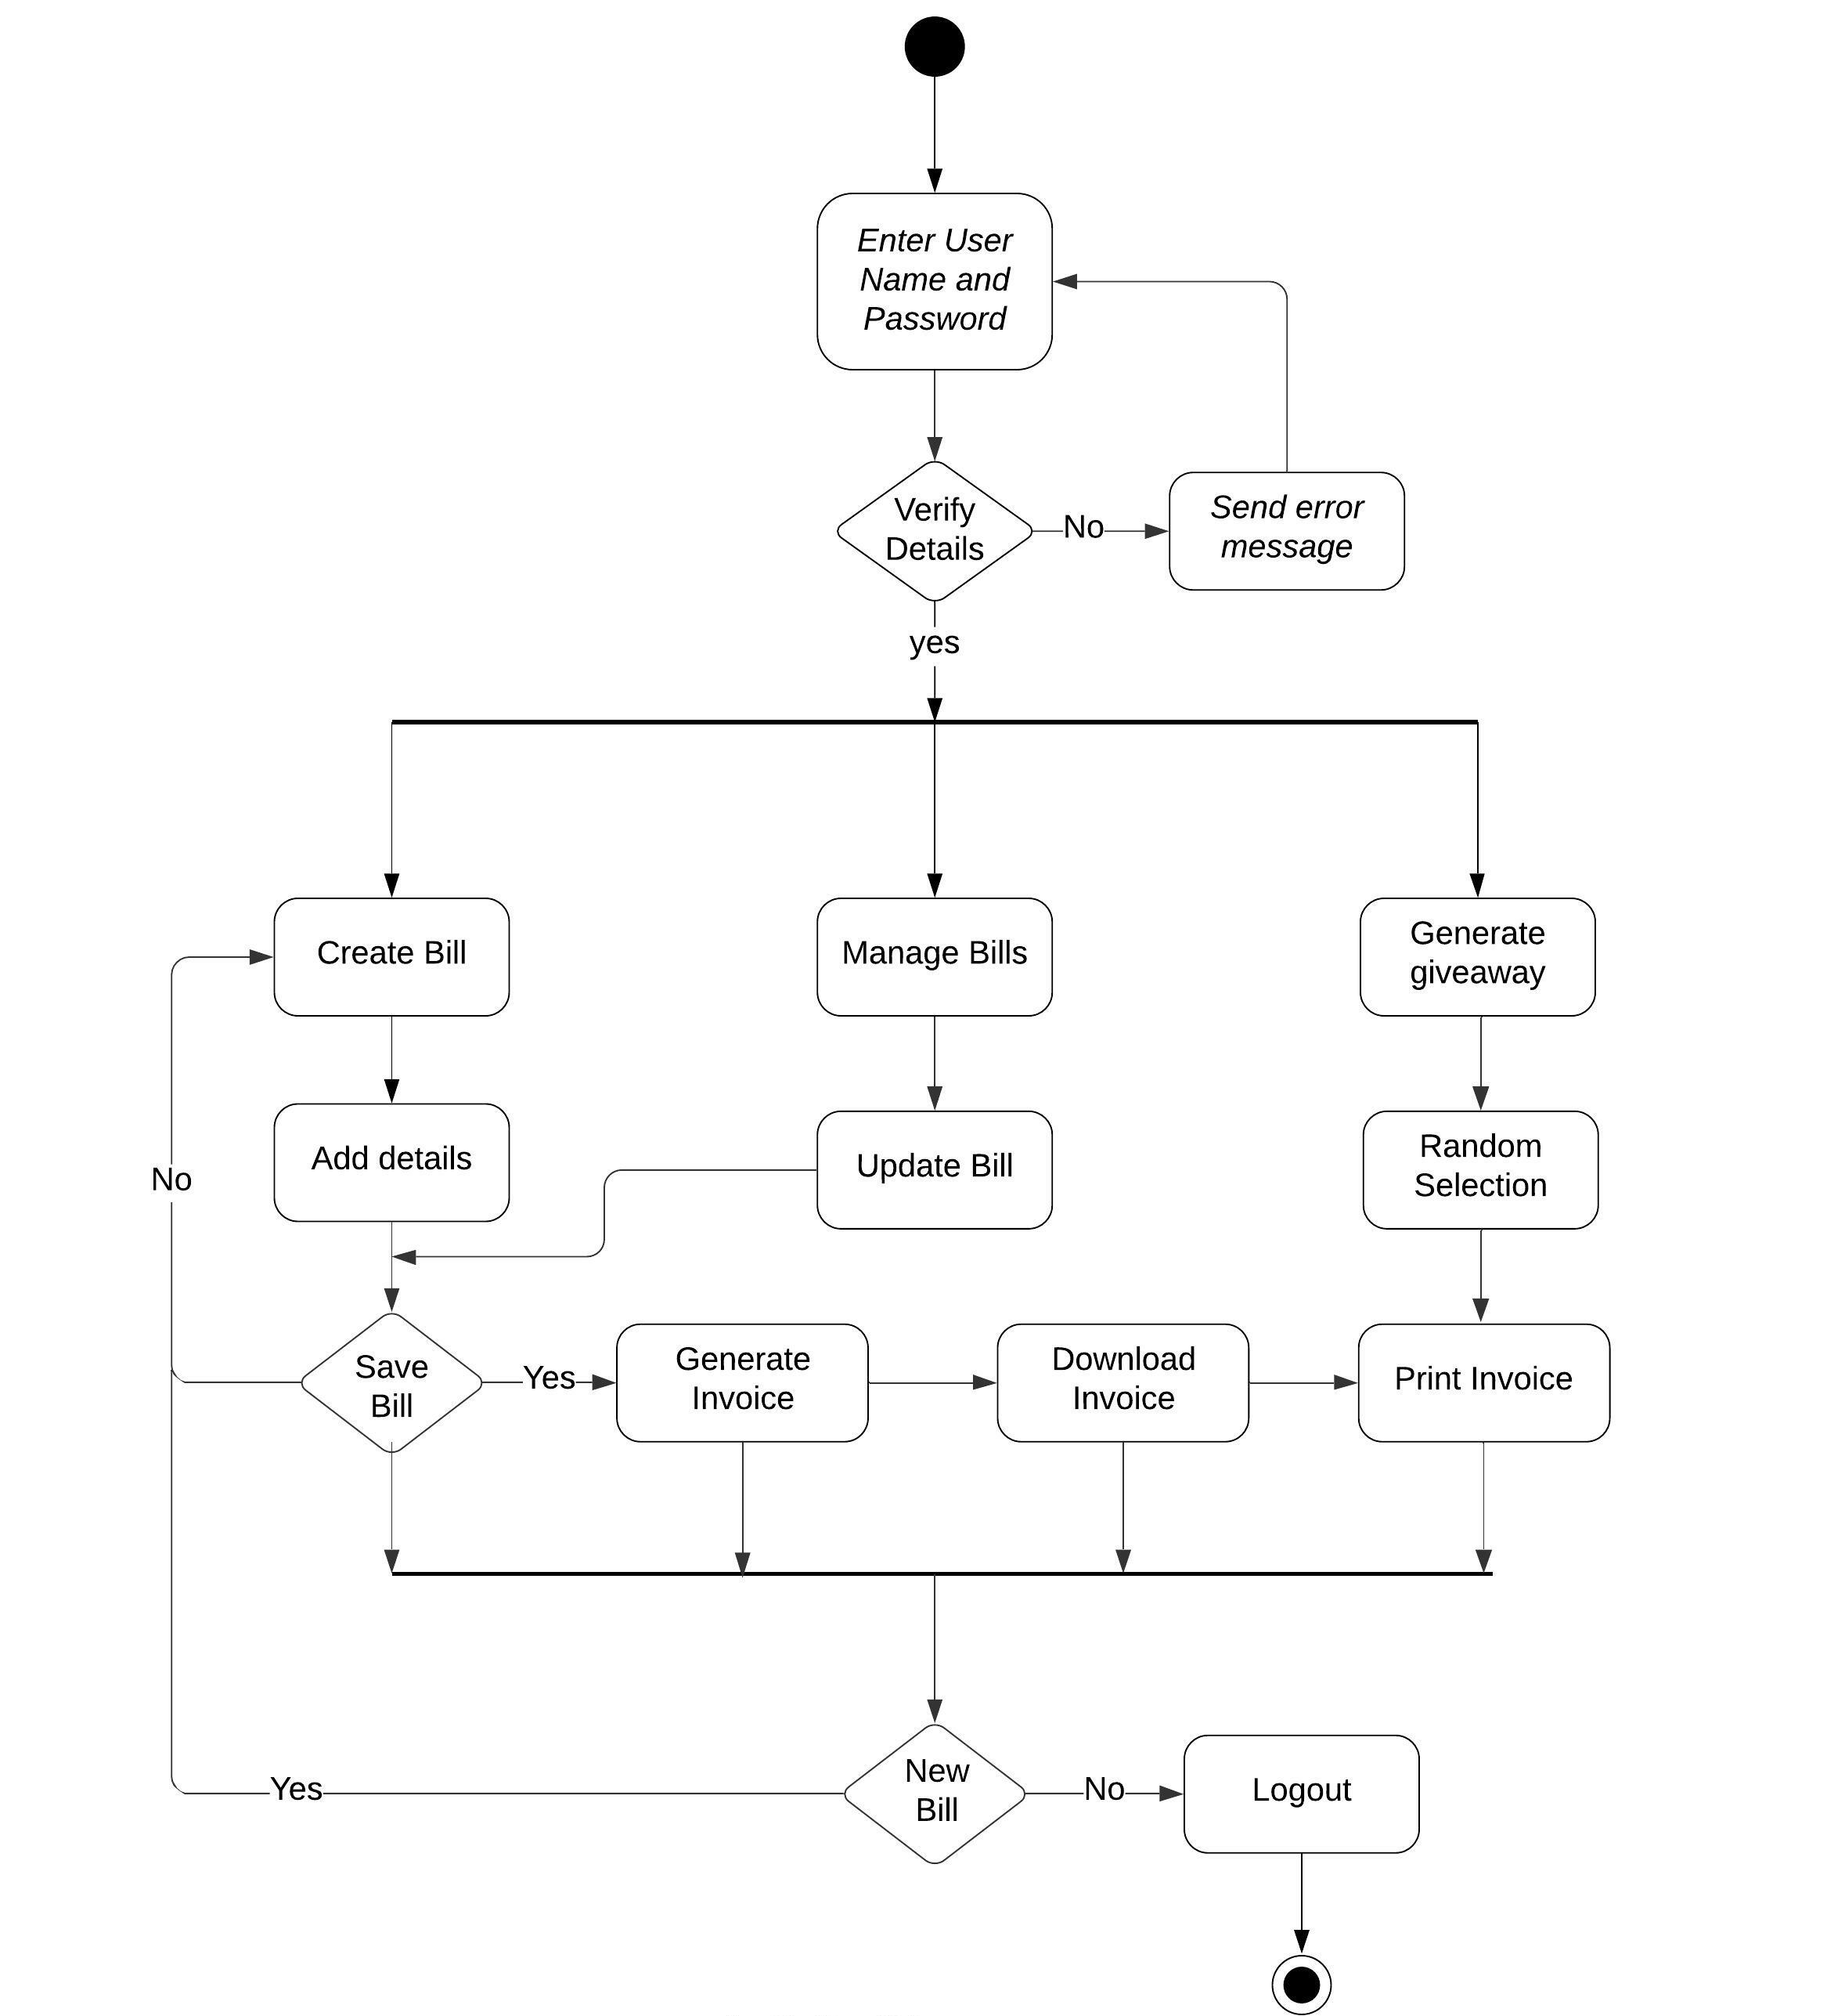
Activity Diagram

Slide 7
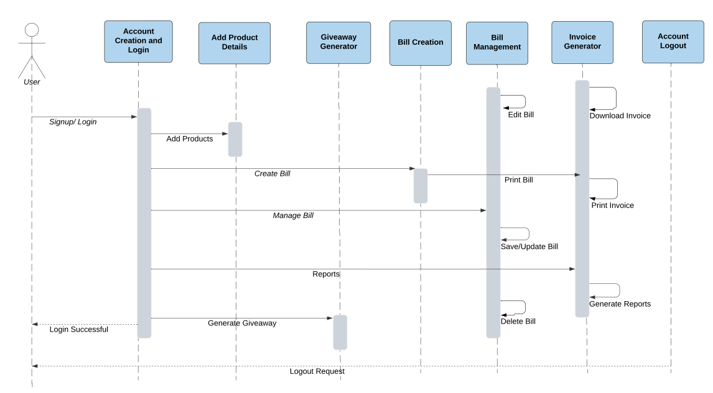
Sequence Diagram

Slide 8
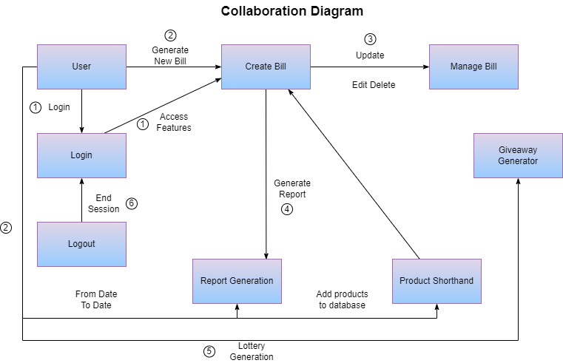
Collaboration Diagram

Slide 9
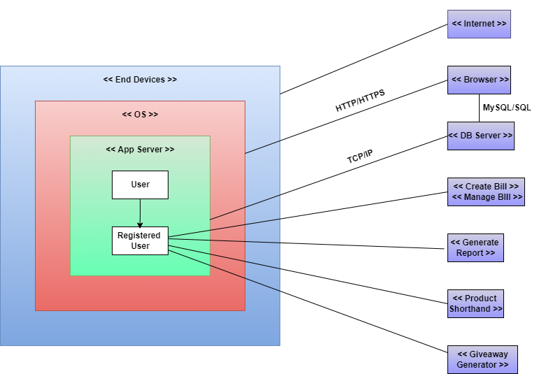
Deployment Diagram

Slide 10
MODULES
Account creation module - Sign in, Sign up
Bill Generation module - Create, Read, Update, Save
Report Generation module - Print, Download
Bill Calculation Module - Math, computation
Admin module - Managing user modules
Product Shorthand notation module
Random giveaway generator module
Logout module - Session Delete

Slide 11
FUTURE SCOPE
The application is made to keep track of data from a wide range of businesses.
Order confirmation invoices to customer’s devices.
Provides an easy billing pattern solution.
Bill/Invoice creation is instantaneous.
On a regular basis, generates report summaries for the owners.
At times, a user-giveaway feature will be planned with a bill / invoice generation.

Slide 12
THANK YOU

